Slide 1
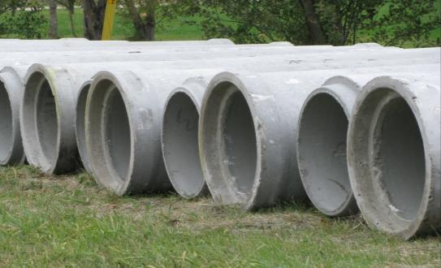
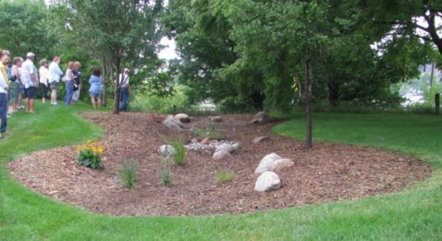
Stormwater Best Management Practices: Cost Saving Ideas
League of Nebraska Municipalities
2011 Midwinter Conference

Slide 2
Session Outline
Introductions
Stormwater Management & BMP Overview
UNL Stormwater Management Programming
LID and Conventional Cost Comparisons
Some Examples from Wayne
Questions and Discussion

Slide 3
Presenters
Lowell Johnson
City Administrator - Wayne, NE
Steven N. Rodie, ASLA
UNL Extension Landscape Specialist and
Associate Professor Agronomy and Horticulture
College of Architecture Landscape Architecture Program
Katie Underwood, PE
Olsson Associates - Omaha, NE
David P. Shelton
UNL Extension Agricultural Engineer and
Professor Biological Systems Engineering

Slide 4
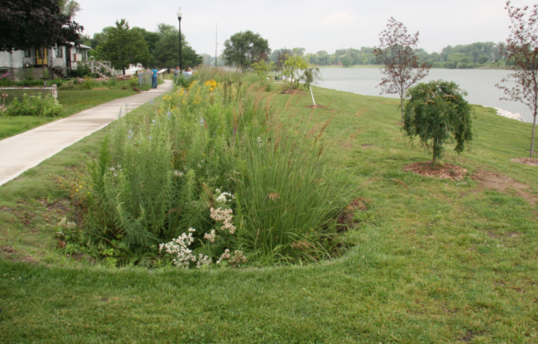
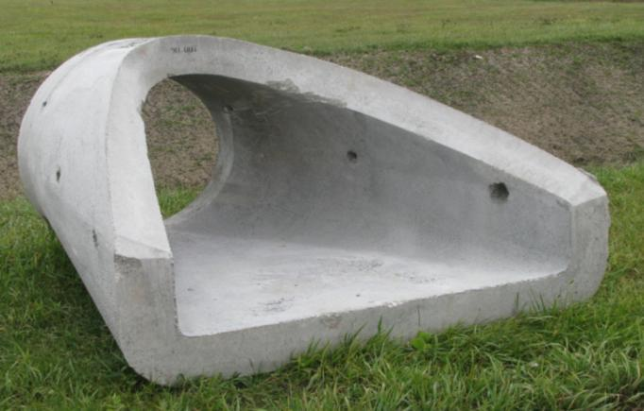
Background
Traditional management approaches treat stormwater in developed landscapes as a problem to be conveyed away as quickly as possible with “gray infrastructure” (curbs, gutters, storm drains, etc.).
The new stormwater paradigm views runoff as a resource to be retained with green infrastructure (rain gardens, bioswales, rain barrels, eco roofs, bioretention cells, etc.) and used on-site or allowed to infiltrate.

Slide 5
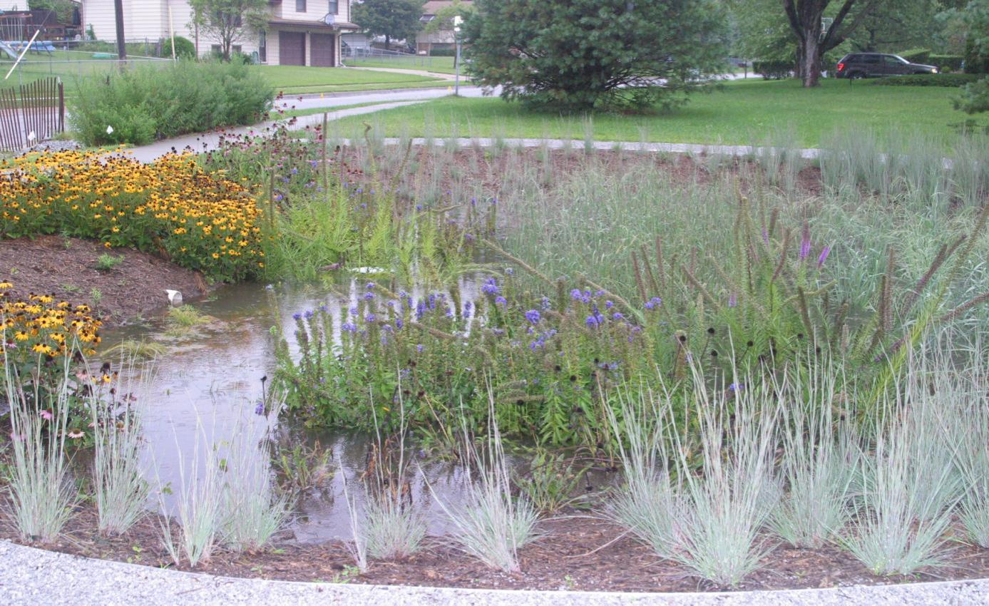

Stormwater Management and BMP Overview
Steven N. Rodie, ASLA
Steven N. Rodie, ASLA
Assoc. Professor/Landscape Horticulture Specialist
Department of Agronomy/Horticulture
Landscape Architecture Program

Slide 6
Overview
Stormwater management – defined as a problem or opportunity?
  Paradigms/perceptions need shifting
  We like our nature well-behaved
  No such thing as no maintenance
Best management practices overview
Key considerations
  Combining successful design, construction and maintenance
  Comparing all of the costs & benefits

Slide 7
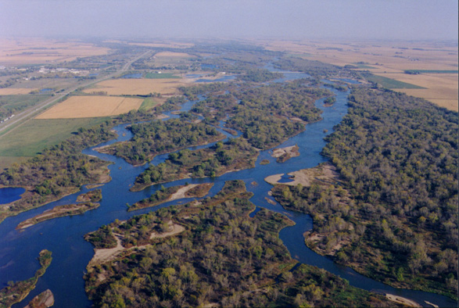
Why should stormwater be managed?
Water issues
  Quality (contaminants and temperature)
  Quantity (too little and too much )
Clean Water Act, stormwater regulations
Water conservation & protection start at home; everyone lives in a watershed and can impact water quality in other locations
Photo: University of Nebraska - Kearney Platte River Page
Notes:
Quantity: Only so much water on earth. World Population grows, we use more…….., contamination, droughts
Quantity: Too much: Extremes in storms; imperviousness of urban areas, increased urbanization
Quality: More people, more technology, more urban areas, more imperviousness + increased pollutants
“Small scale actions by individuals can help make a difference”

Slide 8
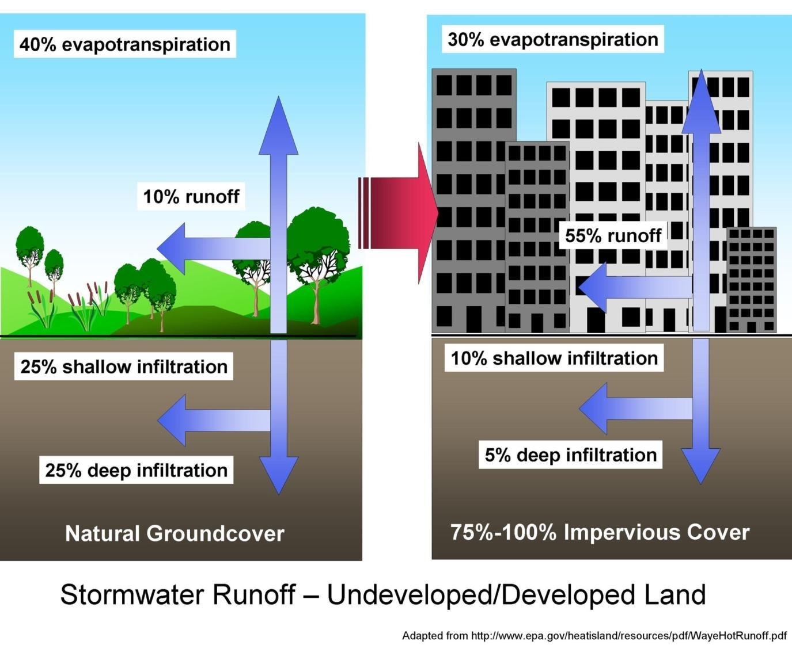
Diagram to show pre/post development changes
To water runoff

Slide 9
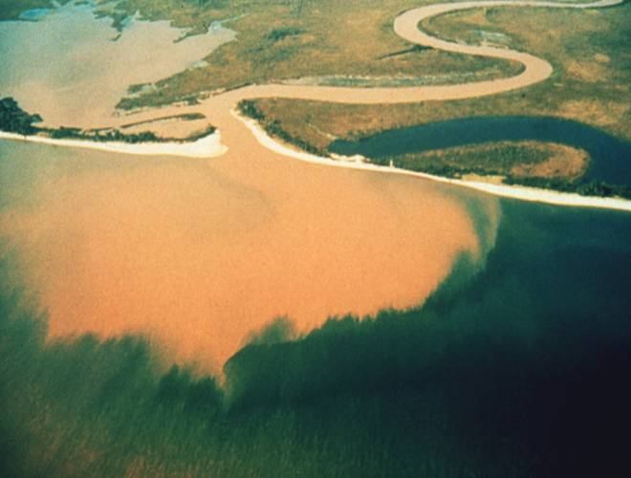
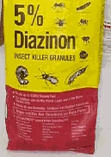
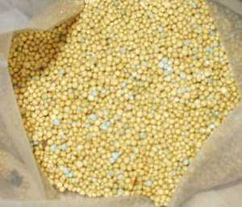
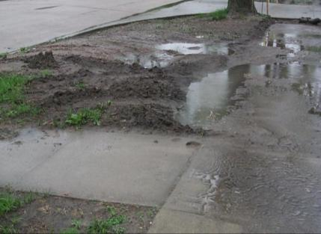

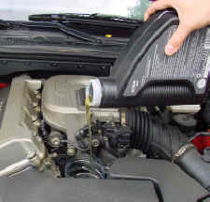


Run-off pollution (nonpoint source pollution) is considered to be one of the leading causes of water pollution today
Notes:
Soil clouds water and degrades habitat for fish and water plants. Sediment also can destroy aquatic habitats. Excess nutrients promote growth of algae, which crowds out other aquatic life. Toxic chemicals such as antifreeze and oil leaking cars, carelessly applied pesticides and zinc from galvanized metal gutters and downspouts threaten health of fish and other aquatic life. When algae die, they sink to the bottom and decompose in a process that removes oxygen from the water. Fish and other aquatic organisms can't exist in water with low dissolved oxygen levels. Bacteria and parasites from pet waste and other pathogens can make nearby lakes and ponds unsafe for wading and swimming after storms, often making beach closures necessary. Debris–plastic bags, six-pack rings, bottles and cigarette butts–washed into water bodies can choke, suffocate or disable aquatic life like ducks, fish turtles and birds.
Contamination of drinking water can occur if polluted stormwater flows down poorly sealed wells or an unused well which has not been properly decommissioned; or leaching to groundwater in sandy soils.
(Source: Farm A Syst Fact Sheet 17 “Improving Stormwater Mangement at Residential Sites” UNL EC 98-795-S) and City of Norfolk website

Slide 10
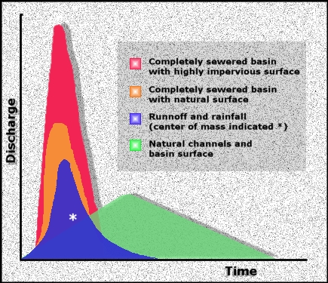
Changes to water temperature and
time/amount of concentration create
significant impacts
Source: Goudie, Andrew, "The Human Impact on the
Natural Environment", The MIT Press, 1994.
http://www.epa.gov/heatisland/resources/pdf/WayeHotRunoff.pdf

Slide 11
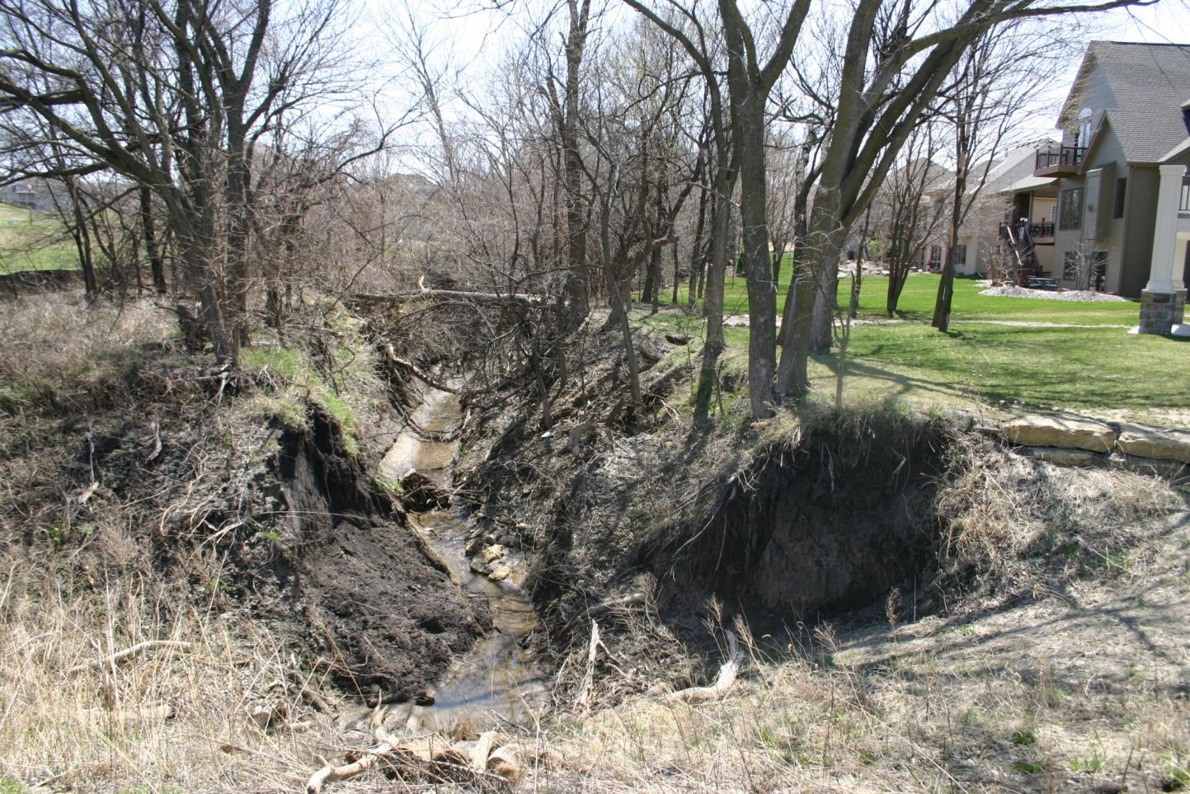

Slide 12
Stormwater Management – Problem or Opportunity?
Think like nature…paradigm shift required
Look like nature…but not too much
Act like nature…no maintenance, right?

Slide 13
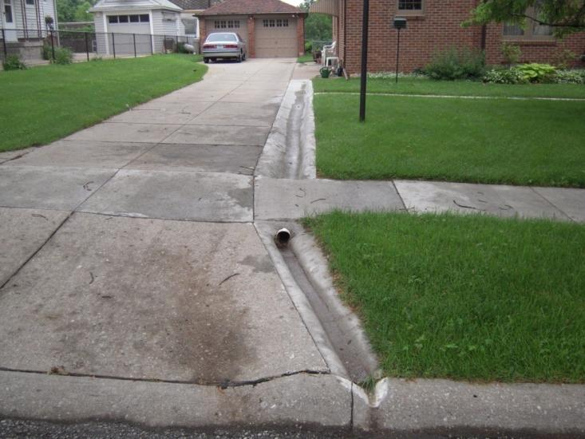
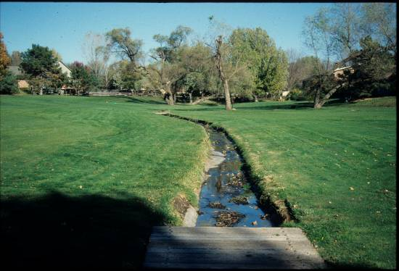
http://www.epa.gov/epaoswer/non-hw/green/pubs/asla-water.pdf

Slide 14
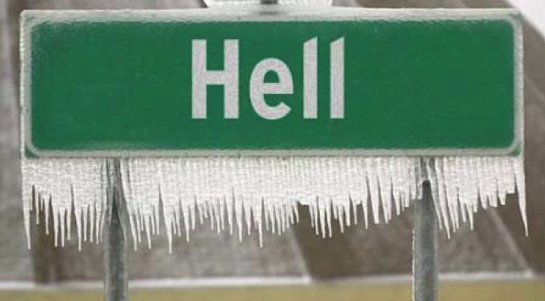
*Paradigm Shift? -- to think like nature thinks?
*"a philosophical and theoretical framework of
a scientific school or discipline…” Merriam Webster Online
http://www.epa.gov/heatisland/resources/pdf/WayeHotRunoff.pdf

Slide 15
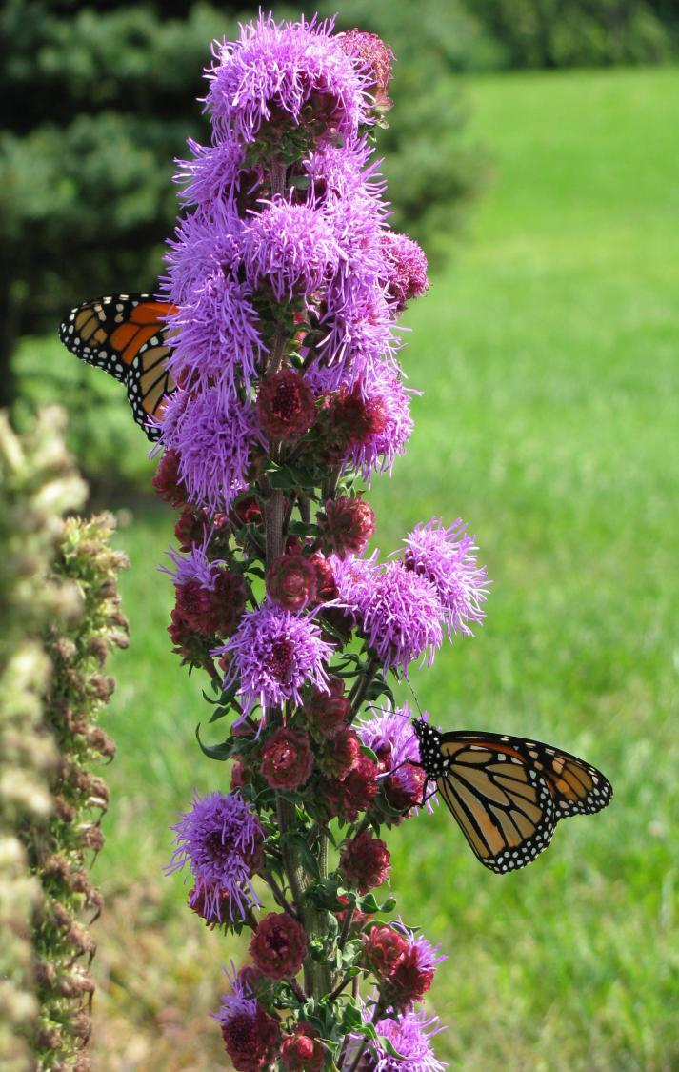
When I am working on a problem I never think about beauty. I only think about how to solve the problem. But when I have finished, if the solution is not beautiful, I know it is wrong.
Designer, architect, author and visionary R. Buckminster Fuller

Slide 16
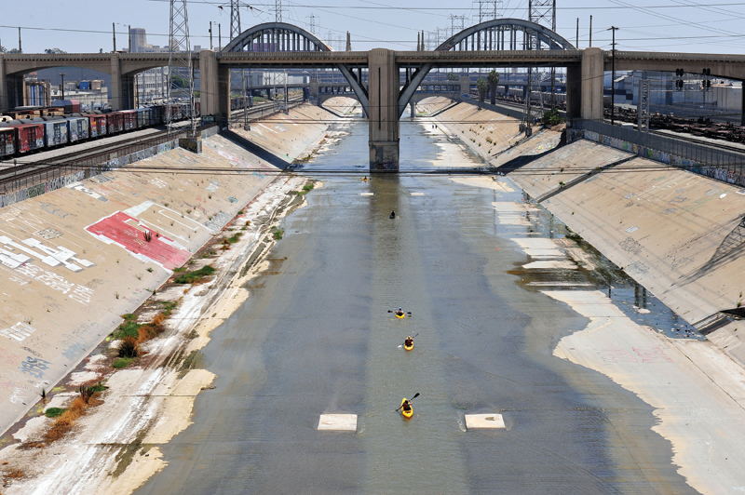
http://www.hcn.org/issues/41.2/non-navigable-river-blues/image_viewer

Slide 17

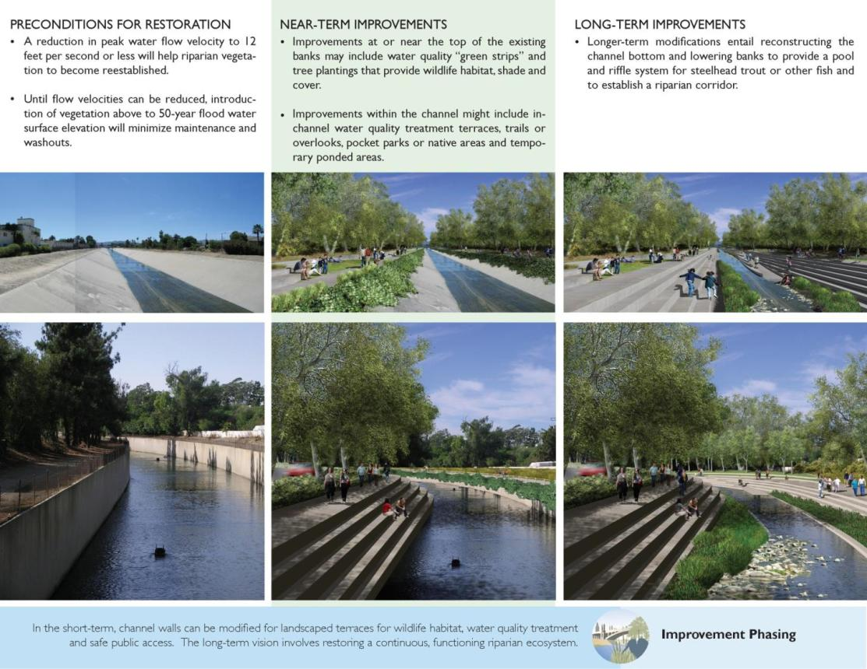
http://www.asla.org/2009awards/064.html

Slide 18
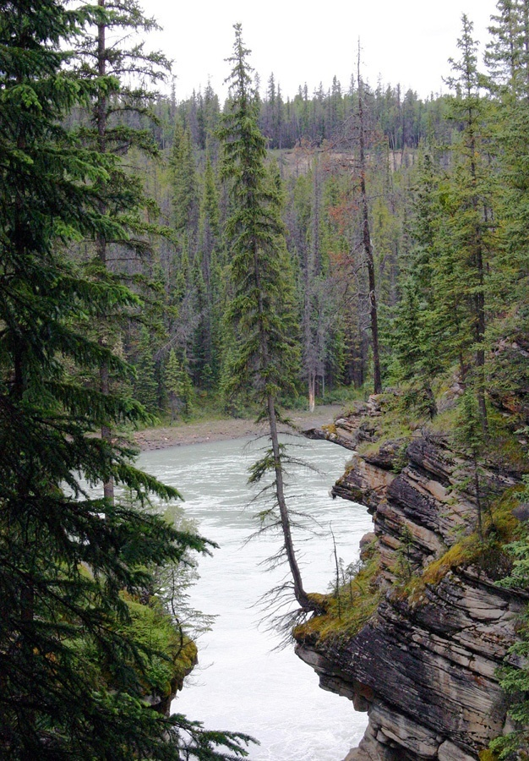
Look deep into nature, and then you will understand everything better.
Albert Einstein

Slide 19
Low Impact Development (LID)
“The main objective of low impact development is to help protect aquatic resources, water quality, and the natural hydrology of a watershed as development takes place.”
“LID is based on the premise that nature knows how to manage water and stormwater runoff best.”
LID-designed sites use natural vegetation and small-scale treatment systems to treat and infiltrate stormwater runoff close to where it originates.
Puget Sound Online
http://www.psp.wa.gov/

Slide 20
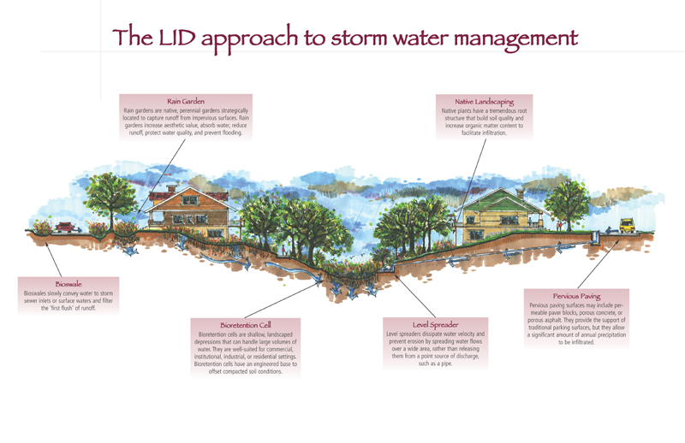
Rain Garden
Rain gardens are native, perennial gardens strategically located to capture runoff from impervious surfaces. Rain gardens increase aesthetic value, absorb water, reduce runoff, protect water quality, and prevent flooding.
Native Landscaping
Native plants have tremendous root structures that build soil quality and increase organic matter content to facilitate infiltration
Pervious Paving
Pervious paving surfaces may include permeable-paver blocks, porous concrete, or porous asphalt. They provide the support of traditional parking surfaces, but they allow a significant amount of annual precipitation to be infiltrated.
Bioswale
Bioswales slowly convey water to storm sewer inlets or surface waters and filter the “first flush” of runoff.
Bioretention Cell
Bioretention cells are shallow, landscaped depressions that can handle large volumes of water. They are well-suited for commercial, institutional, or residential settings. Bioretention cells have an engineered base to offset compacted soil conditions.
Level Spreader
Level spreaders dissipate water velocity and prevent erosion by spreading water flows over a wide area, rather than releasing them from a point source discharge, such as a pipe.
Adapted from http://www.ia.nrcs.usda.gov/news/brochures/LID.html

Slide 21
Kennedy/Jenks Consultants

Slide 22
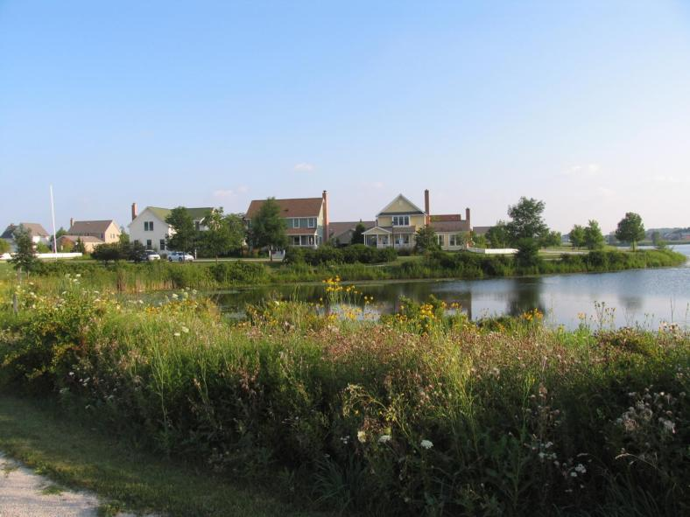
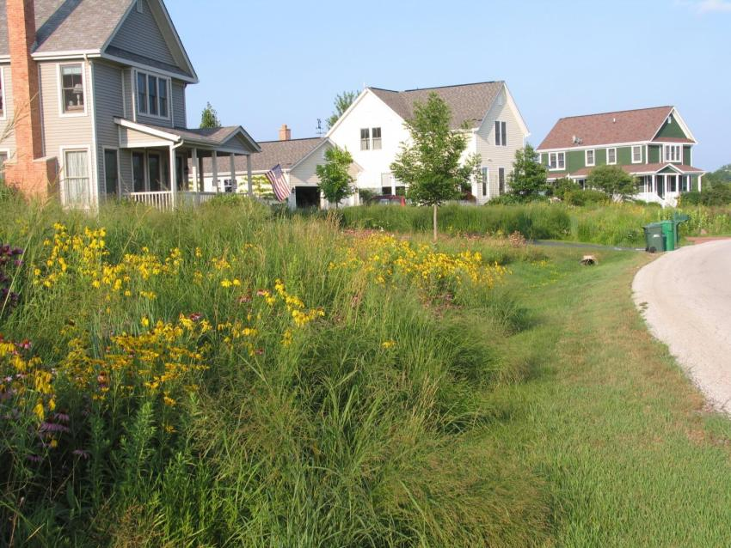

Slide 23
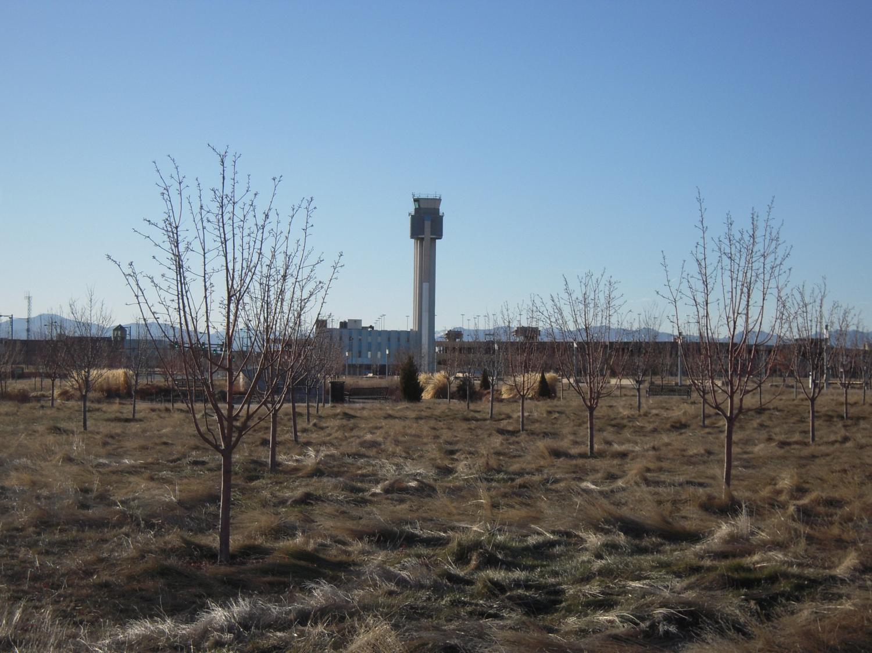

Slide 24
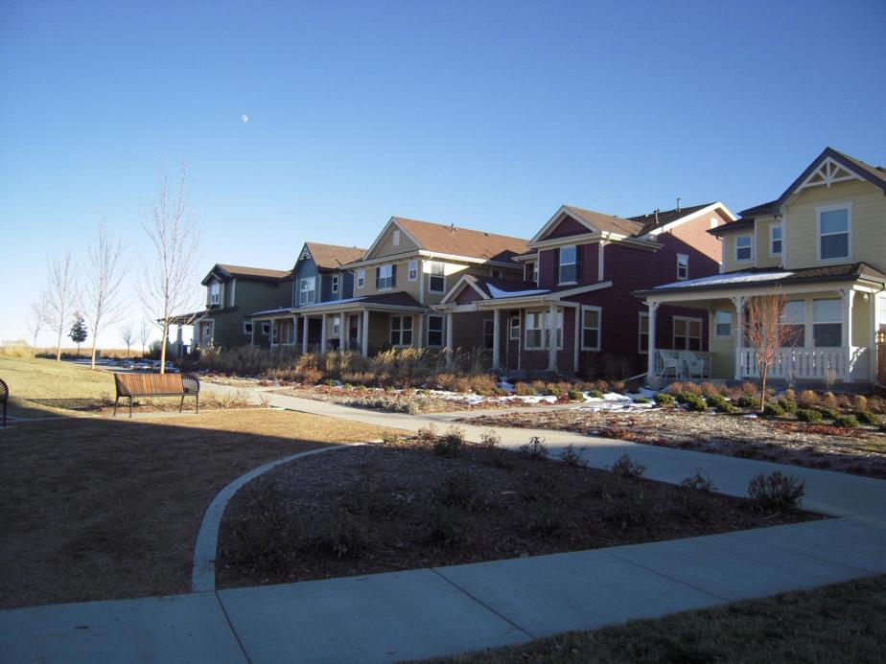
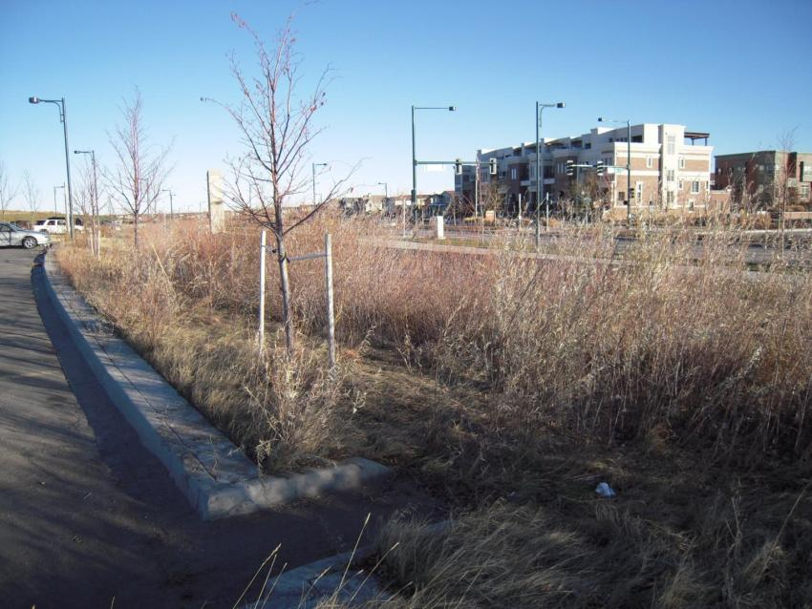

Slide 25
Limitations of LID
New paradigms must be accepted
  “…how do we KNOW they will maintain the rain garden?”
  “….is there an overflow point for this rain garden? I don’t know, it hasn’t overflowed yet…”
Can be difficult to quantify the collective benefits and costs
Does not replace effective land use planning
Some areas may not be suitable for increased infiltration
LID only part of a local comprehensive stormwater program

Slide 26
Green Infrastructure/Technologies
Wet ponds and extended dry ponds
Wetlands
Bioretention cell (Bioswale)
Grass swales
Filter strips and flow spreaders
Sand filters
Porous/pervious pavement
Rain gardens
Rain barrels
Green roofs
From: White Paper – Green Solutions for the City of Omaha (August 2007)
Notes:
White paper copy is on Omaha Public Works website; first cut for PW on green opportunities to manage stormwater (in concert with engineered solutions)

Slide 27
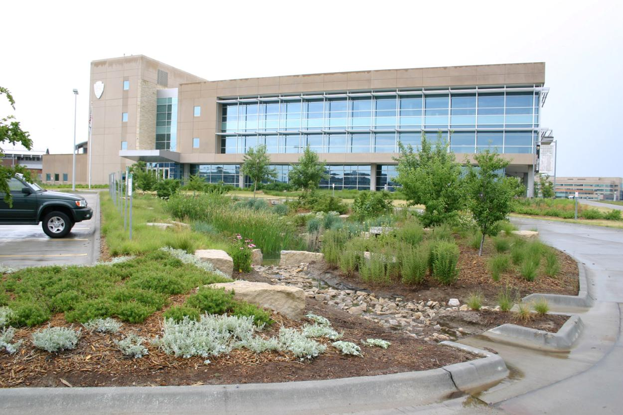
Wet Ponds/Extended Dry Ponds
National Park Service - Midwest Regional Headquarters
Omaha, NE

Slide 28
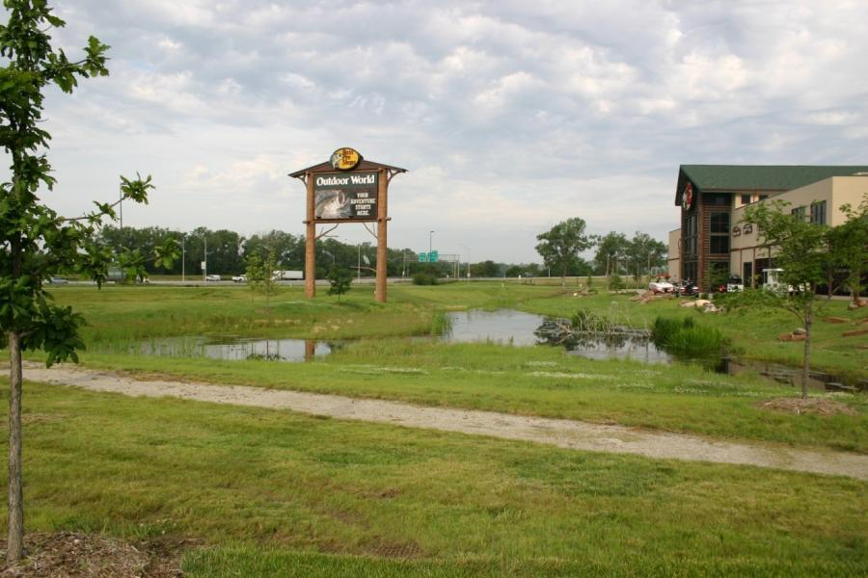
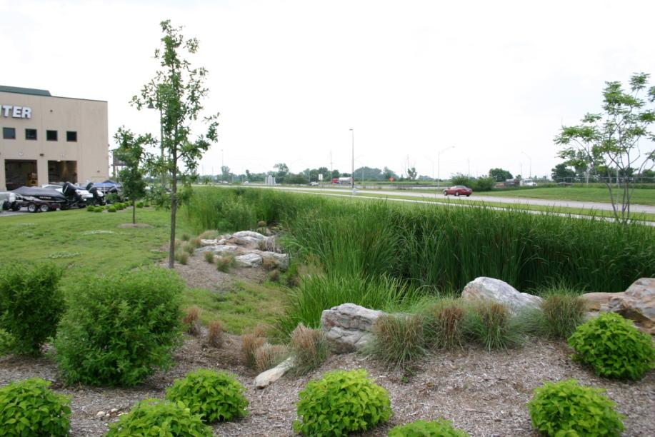
Wetlands
Bass Pro Shop
Council Bluffs, IA

Slide 29
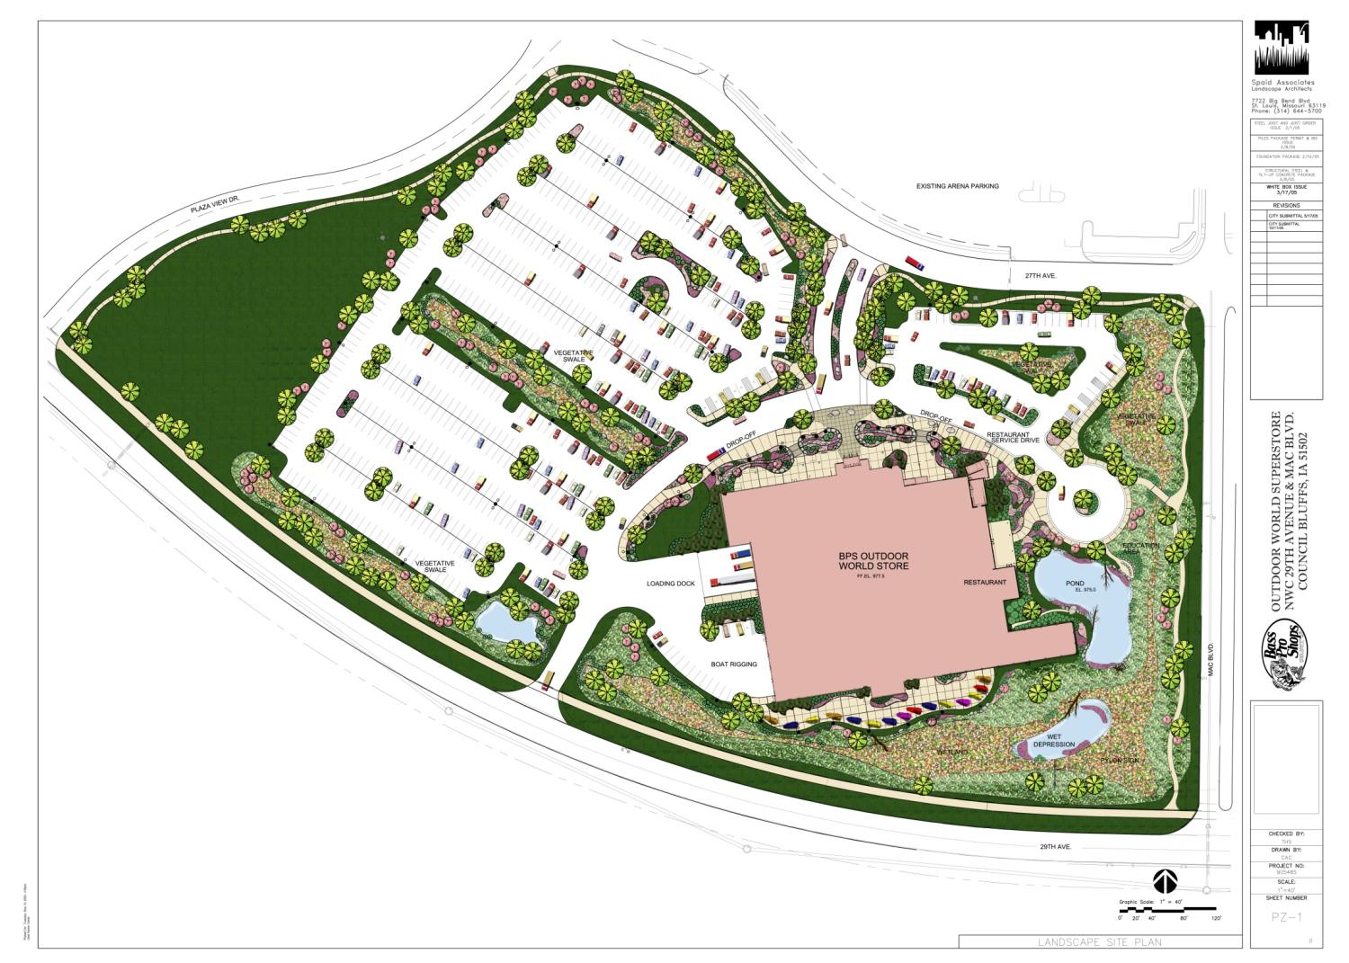

Slide 30
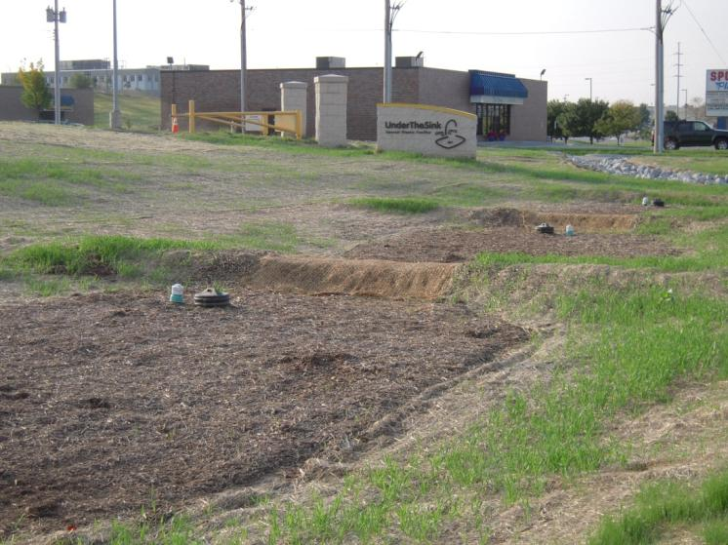
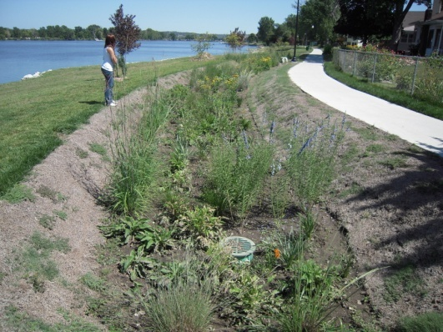
Bioretention Basins
Under the Sink Household Chemical
Disposal Facility
Omaha, NE
Carter lake
Carter Lake, IA

Slide 31
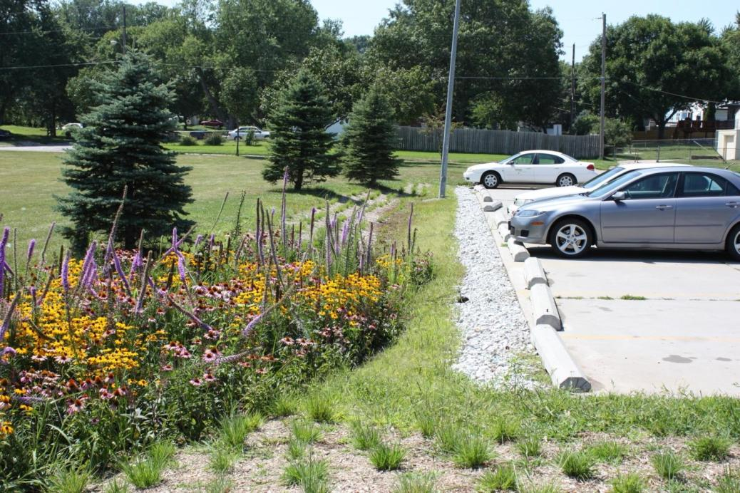
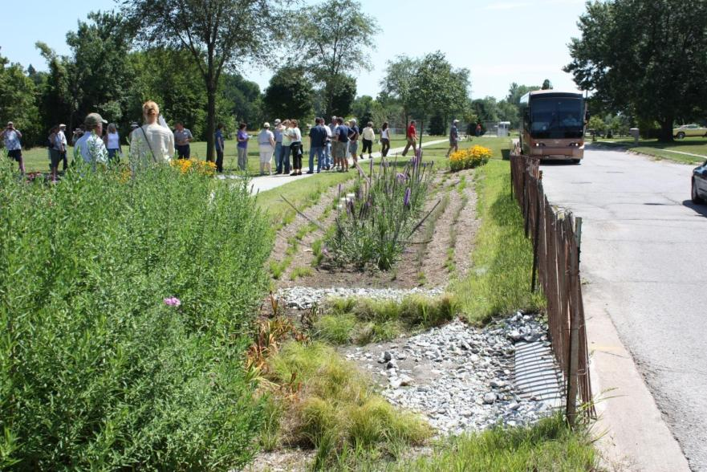

Slide 32
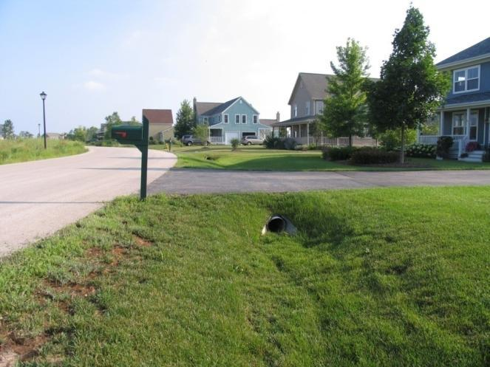
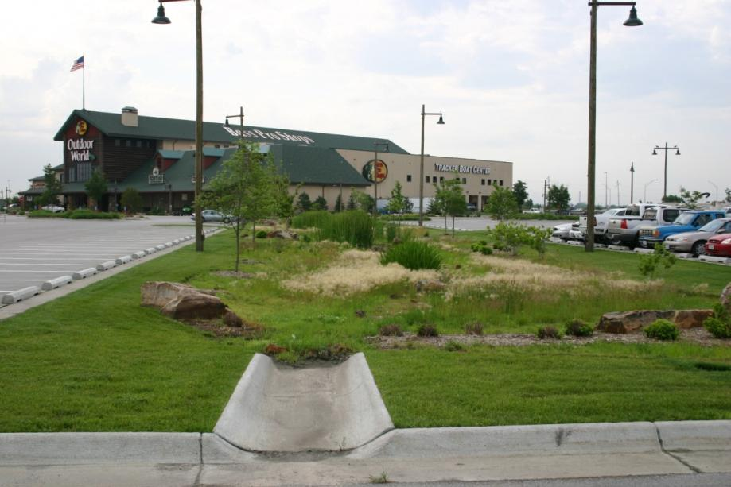
Grass/Vegetated Swales
Prairie Crossing
Grayslake, IL
Bass Pro Shop
Council Bluffs, IA

Slide 33
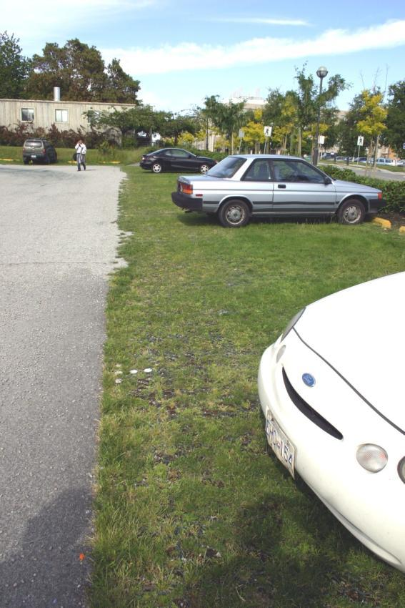
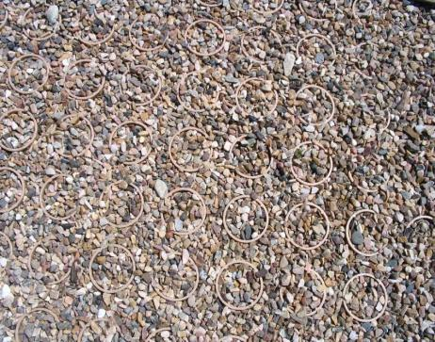
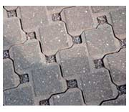
Permeable Pavement
Notes:
Interlocking concrete pavers – Morton Arboretum parking lot – allows natural infiltration

Slide 34
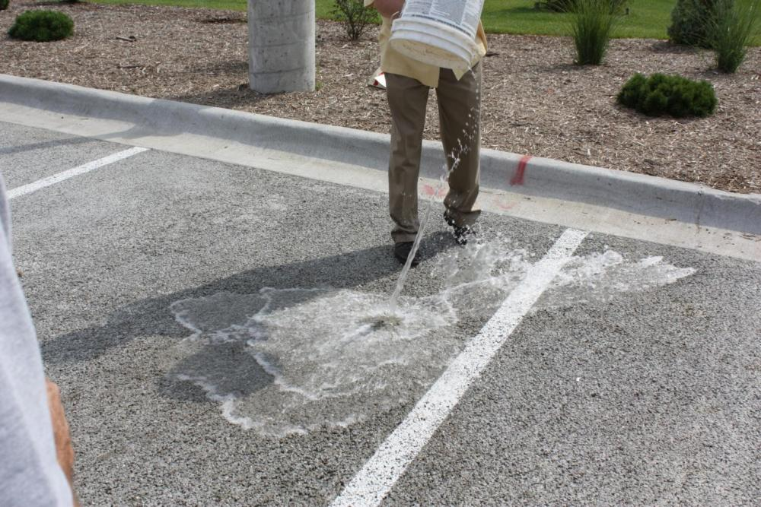
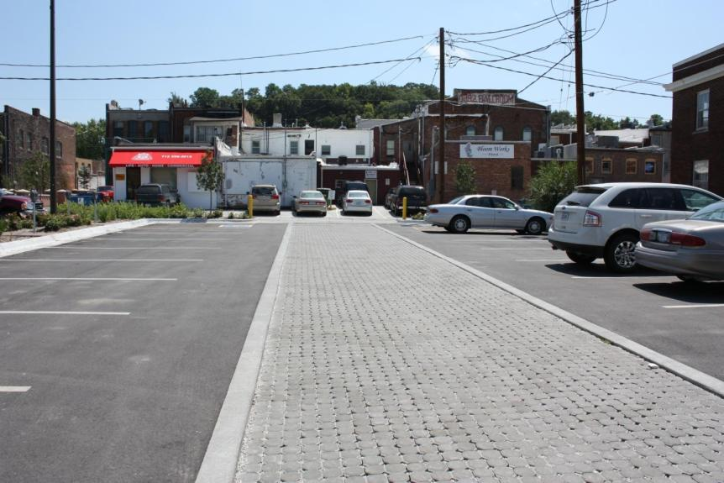
Pervious concrete
Metro Community College
Omaha, NE
Permeable pavers
Council Bluffs, IA

Slide 35
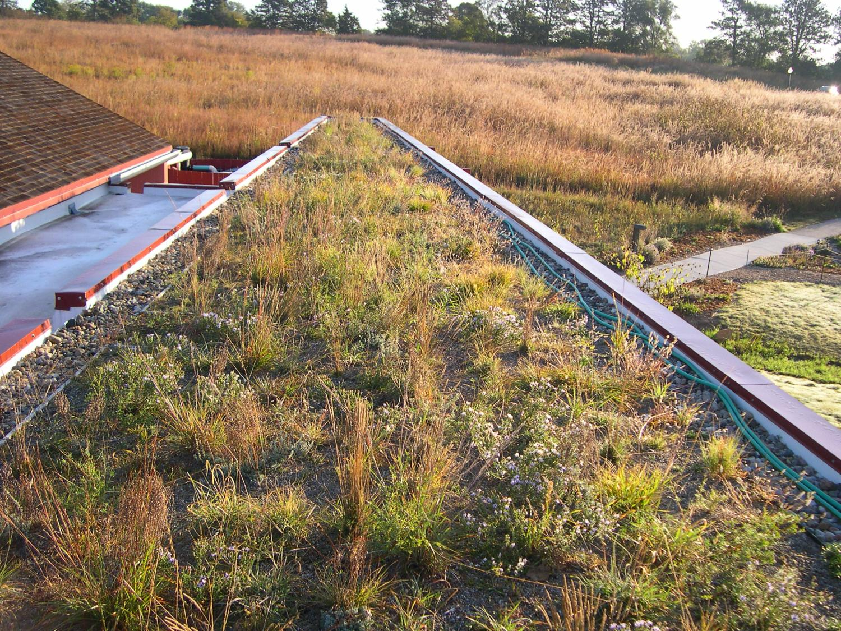
Green Roof

Slide 36
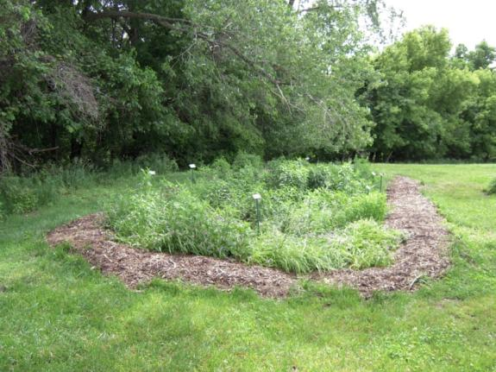
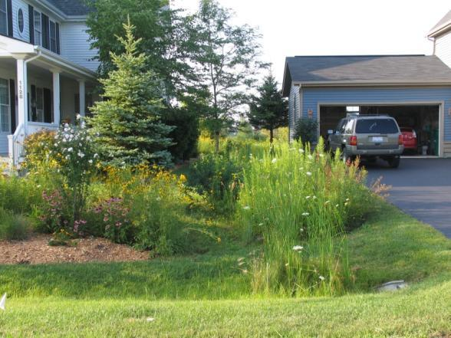
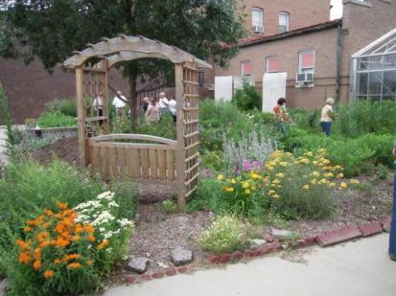
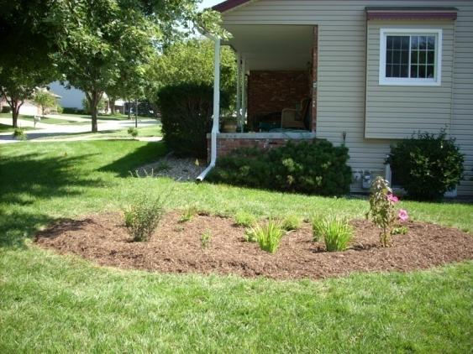
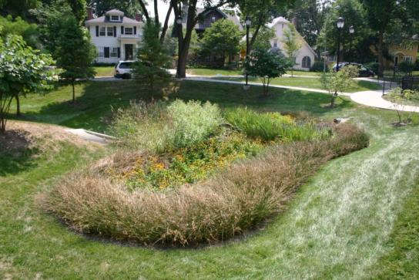
Rain Gardens
Council Bluffs, IA
Grayslake, IL
Lincoln, NE
Kansas City, MO
Council Bluffs, IA

Slide 37
Look like nature….. but not too much
Critical to understand client and public biases and expectation for natural landscape character
“Well-behaved” nature
  physically possible?
  potentially high maintenance and inputs
“Natural nature” - not necessarily low maintenance

Slide 38
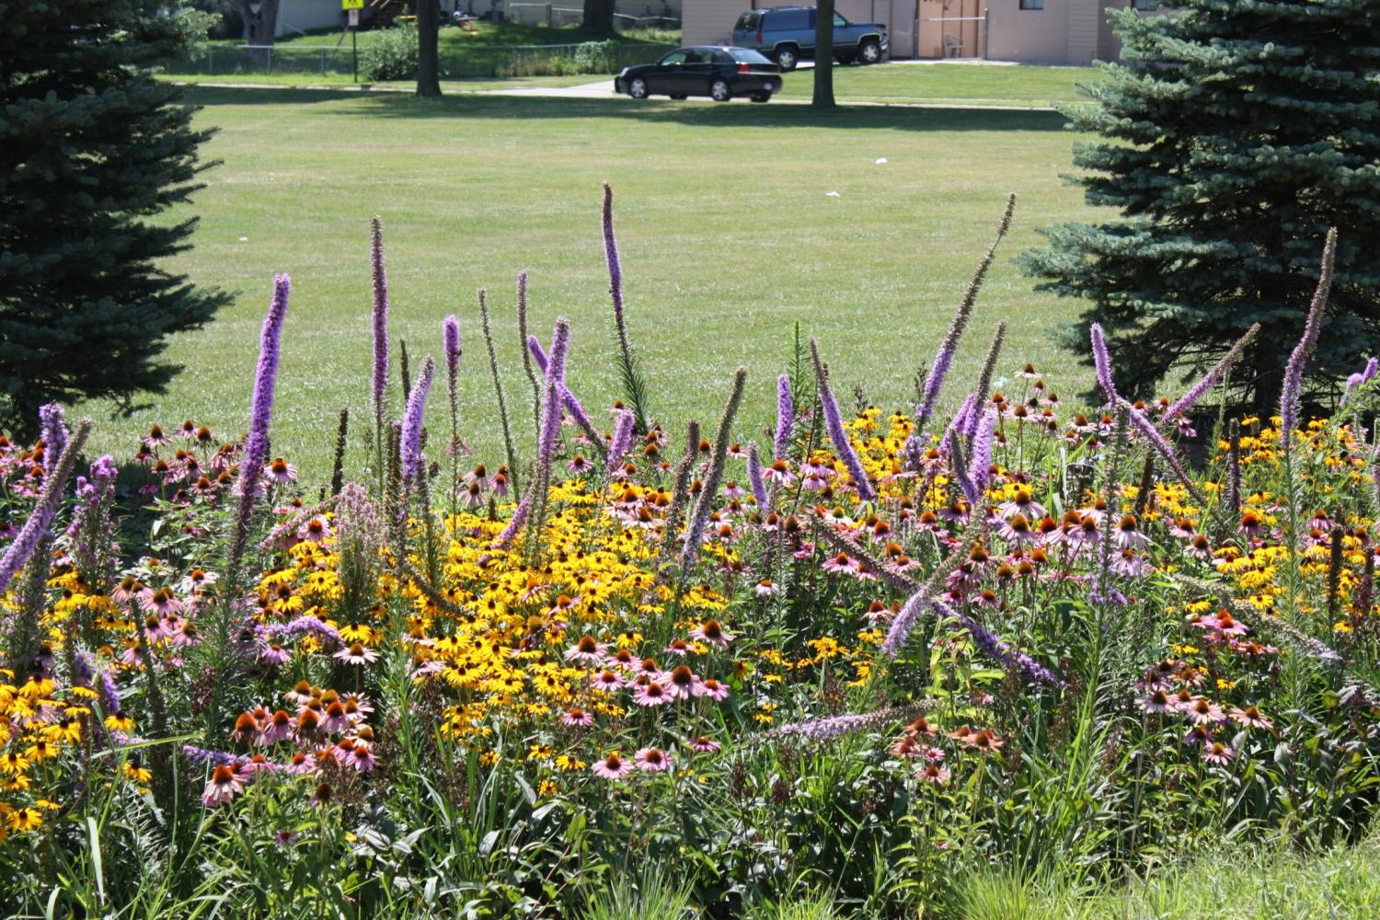

Slide 39
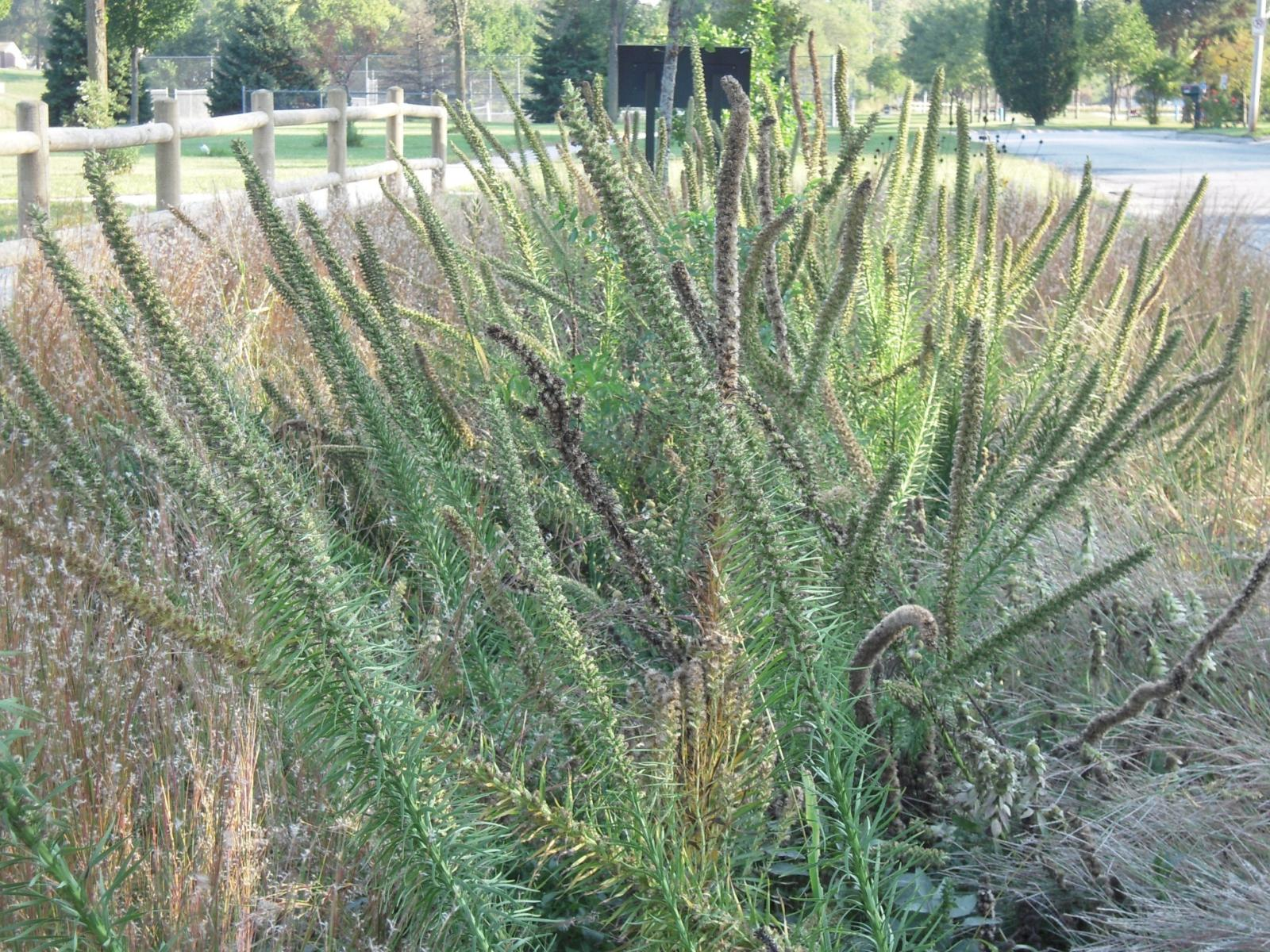

Slide 40


Slide 41


Plant Massing

Slide 42

Defined Edges

Slide 43



Slide 44

Taken for granted as public benefits, ecosystem services (air and water purification, flood and climate regulation, biodiversity, scenic resources, etc.) lack a formal market and are traditionally absent from society’s balance sheet. As a result, their critical contributions are overlooked in public, corporate and individual decision making.
http://www.fs.fed.us/ecosystemservices/pdf/ecosystem-services.pdf

Slide 45

www.sustainablesites.org
Hydrology
Soils
Vegetation
Materials
Human Well-being

Slide 46

http://www.stormh2o.com/july-august-2006/green-stormwater-ecosystem.aspx

Slide 47
Thank You

Slide 48
UNL Stormwater Management Programming
David P. Shelton
David P. Shelton
UNL Extension Agricultural Engineer and
Professor, Biological Systems Engineering

Slide 49

UNL Stormwater Programming
Stormwater and Green Space Work Group
Established in 2006
Initial focus – address needs of Phase II communities across Nebraska relative to stormwater management regulations
Close cooperation with Nebraska Stormwater Cooperative (NSWC) and others
Publication and other material development

Slide 50



UNL Stormwater Programming
USDA-NIFA Grant
Goal - Improve water quality while conserving water resources through an integrated approach to stormwater management and greenspace practice education.
3 years (September 1, 2009 to August 31, 2012) with a one-year extension likely

Slide 51
UNL Stormwater Programming
USDA-NIFA Project Components
  Extension
    Multi-faceted education program
      Meetings, demonstrations, tours, workshops
      Publications and other printed materials
      Virtual tours
      Other techniques
  Teaching
    Landscape architecture curriculum development
  Research
    Evaluation of existing rain gardens
      Hydrologic properties
      Plant growth and performance

Slide 52







UNL Stormwater Programming
Some Publications Available

Slide 53

UNL Stormwater Programming
Website
http://water.unl.edu
Lawns, Landscapes and Gardens
Lawn and Landscape Irrigation
Property Design and Management

Slide 54
Thank You

Slide 55

LID and Conventional Development Cost Comparisons
Katie Underwood, PE
Katie Underwood, PE
Olsson Associates
Omaha, NE

Slide 56


Regulatory Requirements
USEPA MS4 Requirements
  Phase 1-Lincoln and Omaha
  Phase 2-smaller urban areas
Communities Develop Drainage Criteria Plan
  City of Omaha Post Construction Stormwater Quality Ordinance
  Treat the first 0.5 inches of rainfall runoff

Slide 57

Existing Site Design
Conventional Development Design Components
Mass Site Grading
Curb and Gutter Roadway Sections
Concrete Storm Sewers
Large Stormwater Detention Ponds

Slide 58


Low Impact and Conservation Development
Design Objectives
Reduce stormwater runoff
Increase water quality
Integrate and conserve natural resources
Provide aesthetically pleasant and functional neighborhoods
Require minimal long-term maintenance

Slide 59

The Economics of LID and Conservation Development
Olsson Associates completed a Cost Analysis for implementation of BMPs in Overland Park, Ks
Evaluate construction costs of proposed BMP Standards applied to nine (9) local residential and commercial sites:
  6 existing sites in Overland Park (hypothetical BMPs)
  Determine construction costs of actual BMPs constructed on 3 sites in Lenexa, KS
Estimate annual BMP maintenance costs
Compare site cost analysis with national data
Evaluate % of site area dedicated to BMPs

Slide 60
Data was compared to National Averages for BMP Construction
Cost data compiled on eight (8) BMPs installed across the country
Fourteen (14) references cited
Average construction cost of all 8 BMPs researched:
  Residential: $3,500/acre
  Commercial: $11,000/acre
Annual maintenance costs range from 3%-9% of initial construction costs

Slide 61

Nine Sites Studied in Overland Park, KS
Single Family Residential Sites:
Village at Kensington (97 lots, 32 acres)
Chapel Hill (666 lots, 233 acres)
Creekside Woods, Lenexa (67 lots, 26 acres)
Multi-Family Residential Sites:
Corbin Crossing (18 acres)
Townhomes at the Reserve, Lenexa (39 acres)
Commercial/Office Sites:
Dickinson Palazzo Theaters (13 acres)
143rd & Metcalf Office Park (3 acres)
151st & Metcalf Retail (4 acres)
Rosehill Business Park, Lenexa (6 acres)

Slide 62

Single Family Residential
SITE DATA
Lot count: 67
Site Area: 26 acres
BMPs Used:
Detention
Bioretention
Stream Corridor

Slide 63

Multi-Family Residential
BMP DATA
BMPs: Detention, Bioswales, Bioretention, Wetland
Removed 800’ storm pipe

Slide 64

Multi Family Residential
SITE DATA
Site Area: 39 acres
BMPs Used:
Detention
Bioretention
Swales

Slide 65

Business/Commercial Park
BMP DATA
BMPs: Detention, Bioretention, Swales
Removed 160’ storm pipe
Maintained parking count (129)

Slide 66

Cost Summary

Slide 67
Conclusions of OPKS Study
Local site cost data compares well with national data
Economy of scale with larger sites
Bioretention is the most expensive BMP studies by a large margin (up to 5x)
Maintenance costs can vary widely
Different BMPs better for different land uses
Ongoing analysis for City thoroughfares

Slide 68

LID Considerations
Methods of construction (BMPs are not your standard water control structure – nor just another garden).

Slide 69
Thank You

Slide 70

Some Examples from Wayne
Lowell Johnson
Lowell Johnson
City Administrator
Wayne, NE

Slide 71
Wayne Storm Water BMP Thresholds
Disperse Rainfall – Don’t Collect It
Mosquito Control
Adequate Space
Weed Control
No Safety Hazard
10 Year Pay Back or Less

Slide 72

Kardell Industrial Park
North Bio-Swale

Slide 73

Kardell Industrial Park
South Bio-Swale

Slide 74

INDUSTRIAL PARK BIO-SWALE
2,000 LF Bio-Swale @ $24/LF = $48,000
vs.
2000 LF 36” Concrete Pipe @ $52/LF
Two Drop Structures @ $5,000 and $6,000
= $115,000

Slide 75
Industrial Road – No Curb
$16 savings / LF on 28 ft wide concrete paved street x 2,500 LF of street
= $40,000 Savings
Plus elimination of underground
storm drain system

Slide 76

Western Ridge Residential Subdivision Detention Basin

Slide 77

Western Ridge Detention Down Stream

Slide 78

Undersized Storm Drain System Below Western Ridge Subdivision

Slide 79
Benscoter Residential Subdivision
Bio-Swale vs. Storm Drain and Drop Structure
1,200 LF of 48” concrete pipe @ $75/LF plus $7,000 drop structure
= $97,000
vs.
Bio-swale with capacity for 10 year storm 1,200 LF @ $14/ LF installed
= $16,800

Slide 80

Benscoter Residential Subdivision
overview

Slide 81
Subdivision Agreements Requiring Bio-Detention
The final grading for each lot must provide bio-detention capacity for ½” of run-off on the lot from impermeable surfaces on site.

Slide 82

Pick Industrial Subdivision
Be sure to explore all options and opportunities when developing new areas.

Slide 83
Thank You

Slide 84
Closing Thought
…unlike traditional gray infrastructure, which starts depreciating the moment the ribbon is cut, many green infrastructure systems - from street trees to oyster reefs to restored wetlands - appreciate in value as they grow and mature. The greater surface area afforded by the leaves and roots of a large mature tree means that it is exponentially more valuable than a newly planted tree.
http://www.rpa.org/2011/02/spotlight-vol-10-no-3-when-a-park-is-more-than-a-park-and-a-building-more-than-a-building.html (Accessed 2/23/11)

Slide 85
Questions and Discussion

